Slide 1
UNIT-II
Protocols

Slide 2
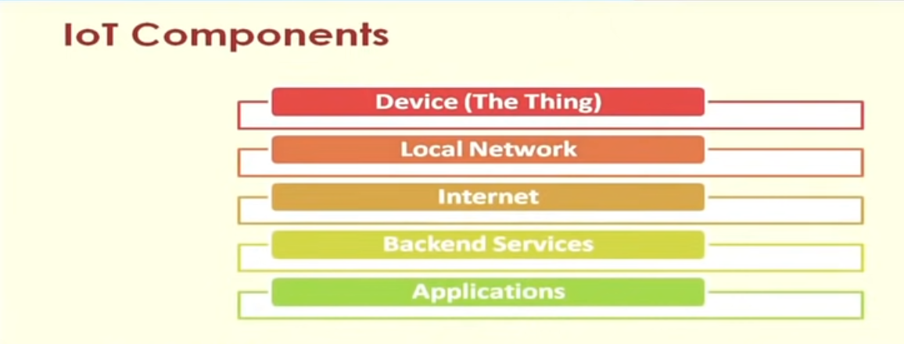
Notes:
Source-NPTEL

Slide 3
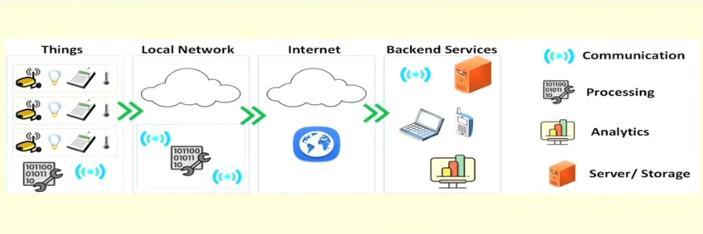

Slide 4
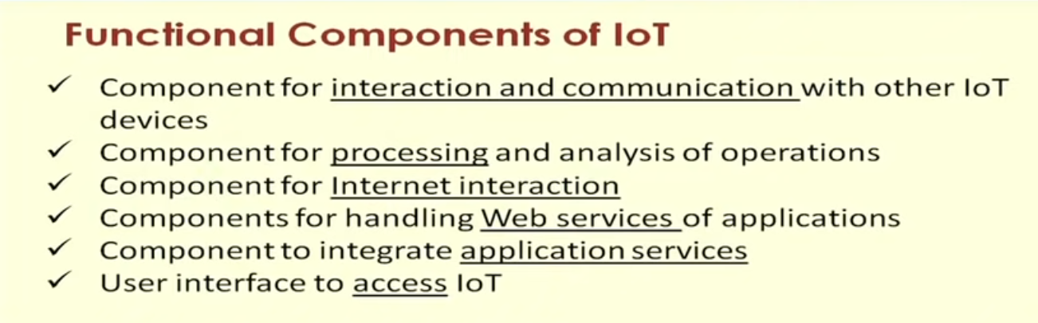

Slide 5
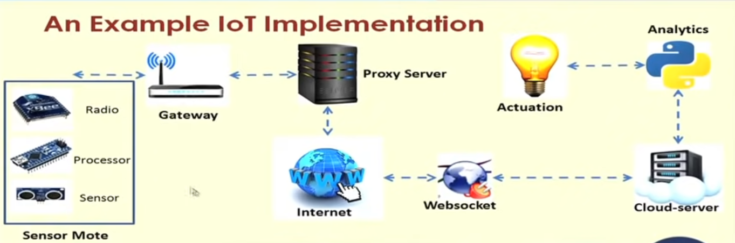

Slide 6
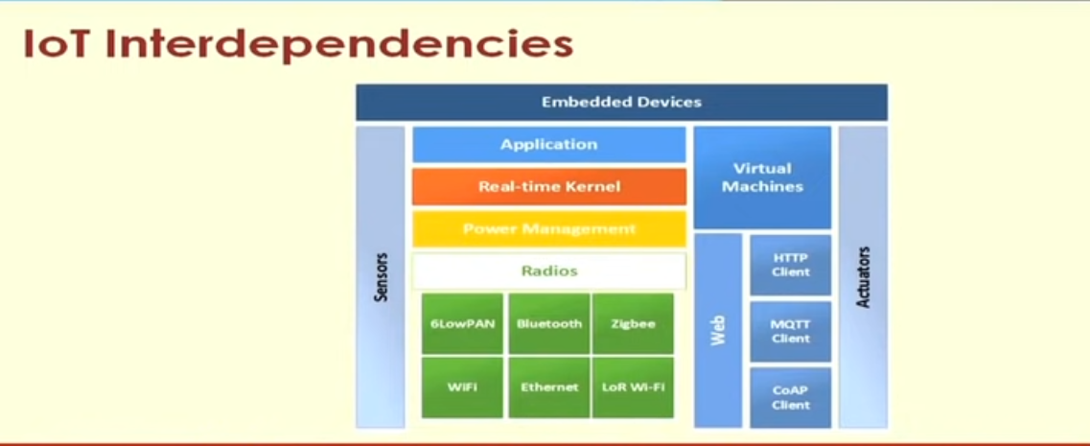

Slide 7
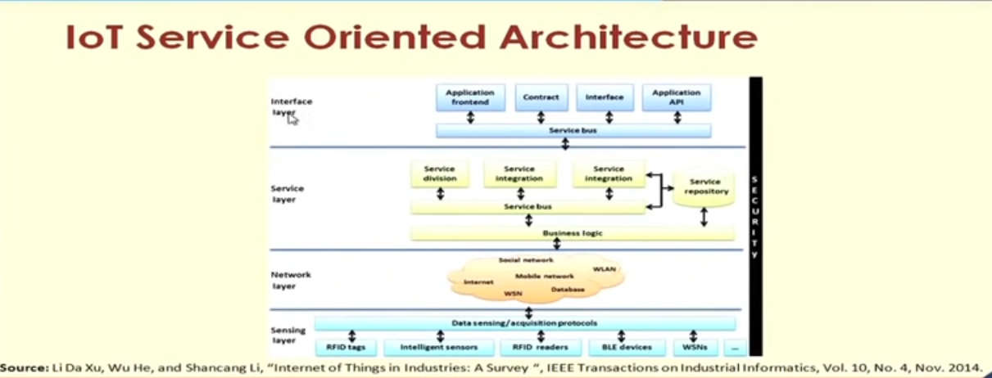

Slide 8
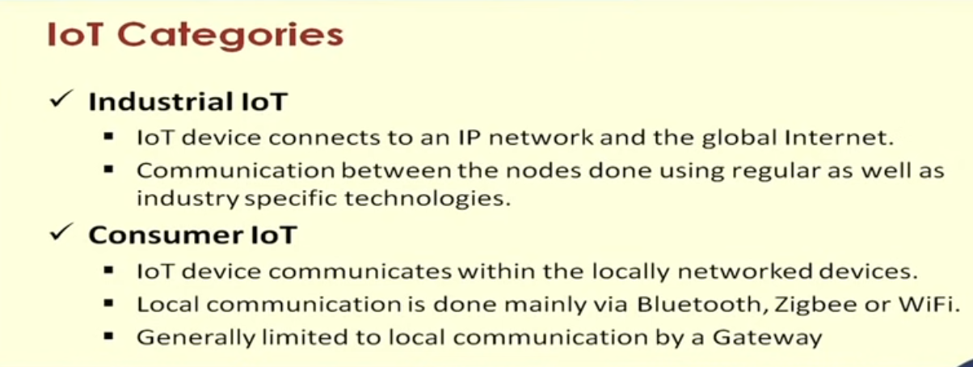

Slide 9
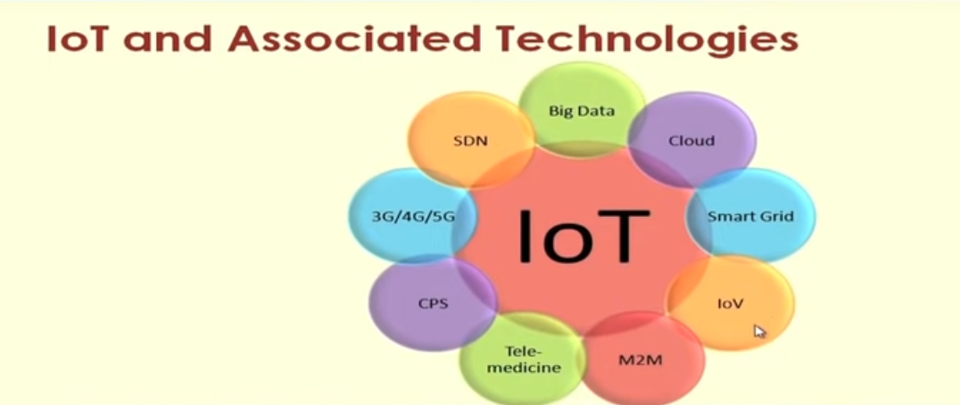

Slide 10
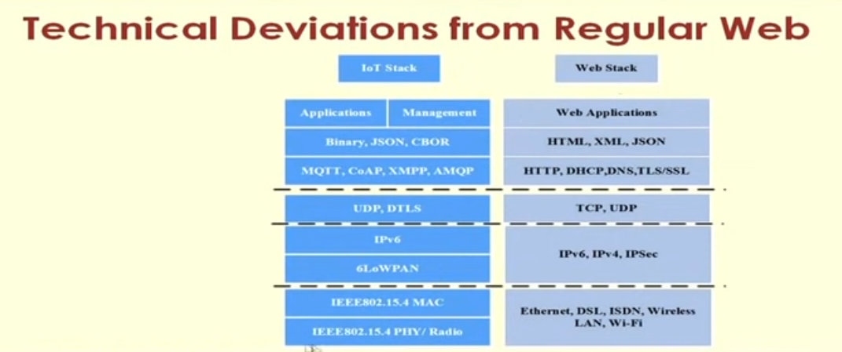

Slide 11
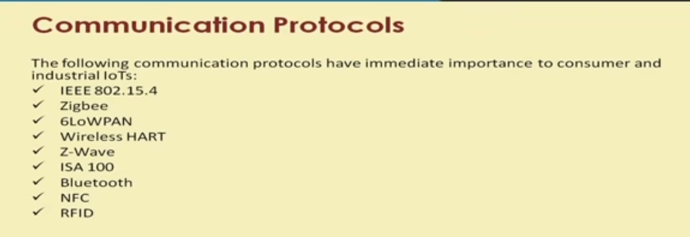

Slide 12
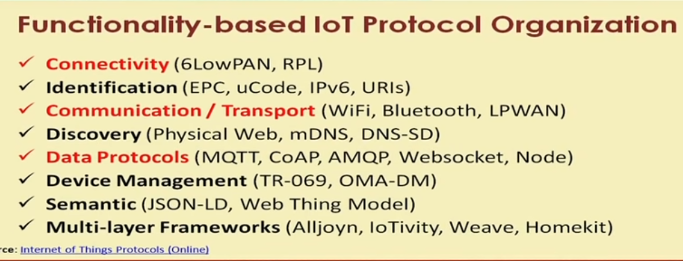

Slide 13
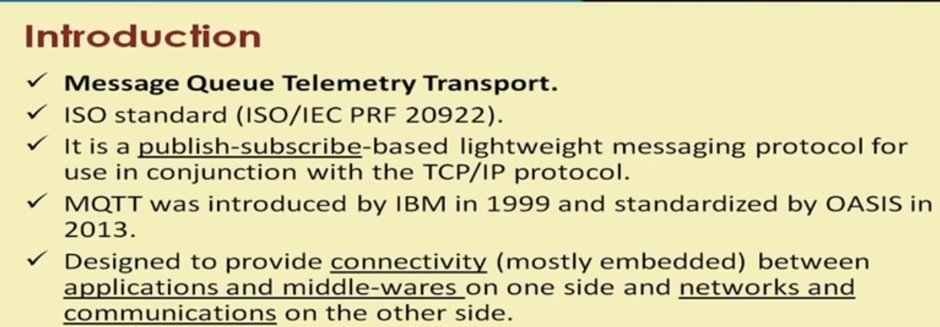
MQTT protocol

Slide 14
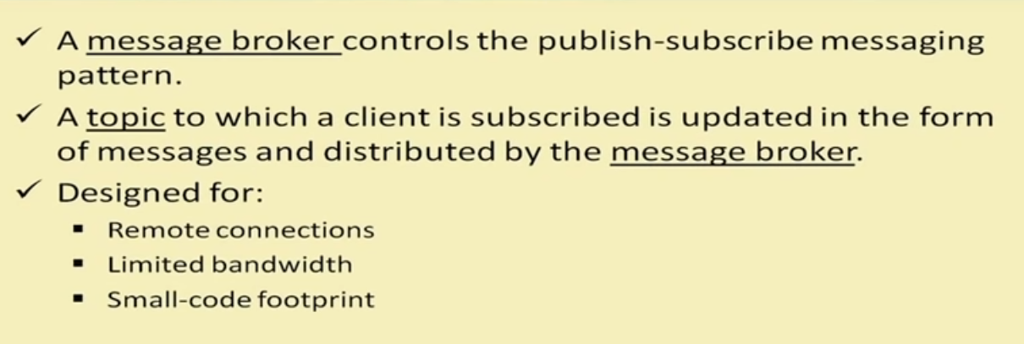

Slide 15
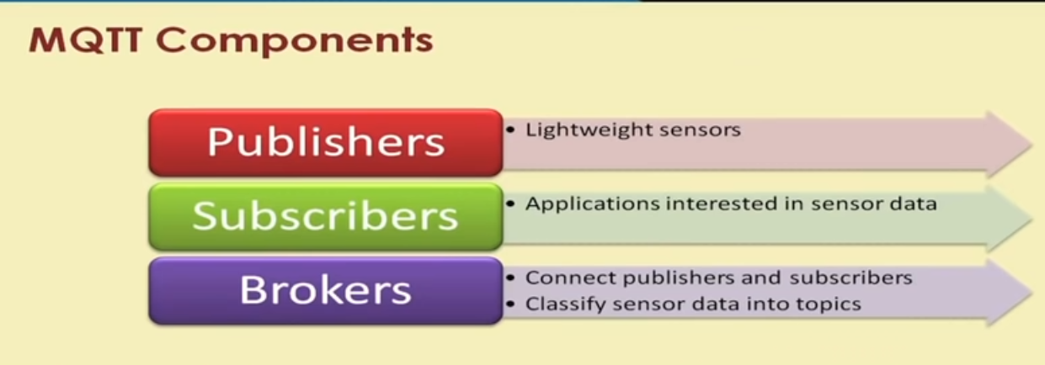

Slide 16
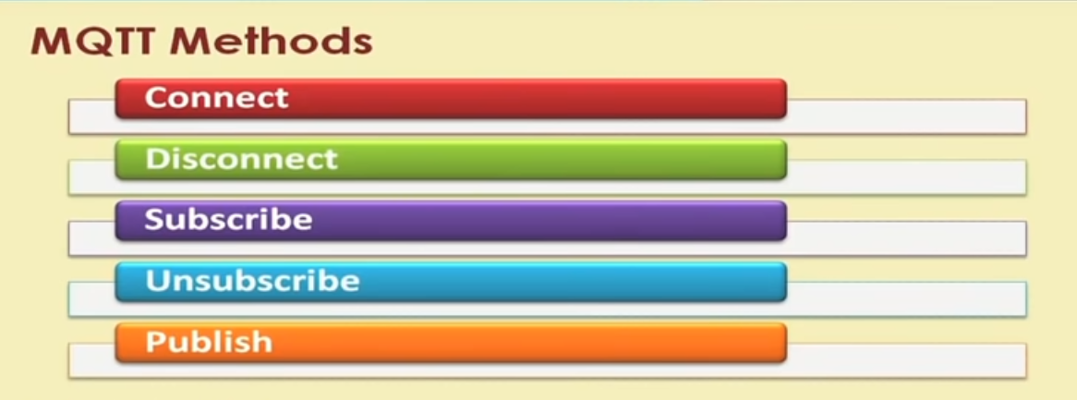

Slide 17
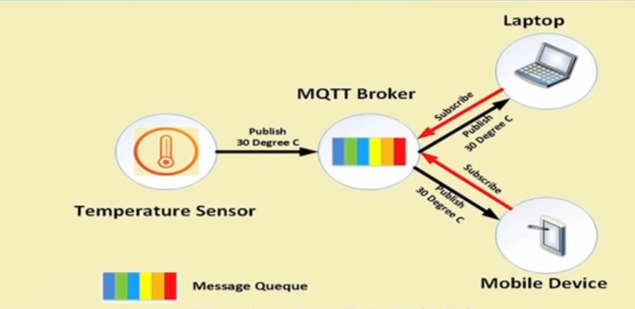

Slide 18
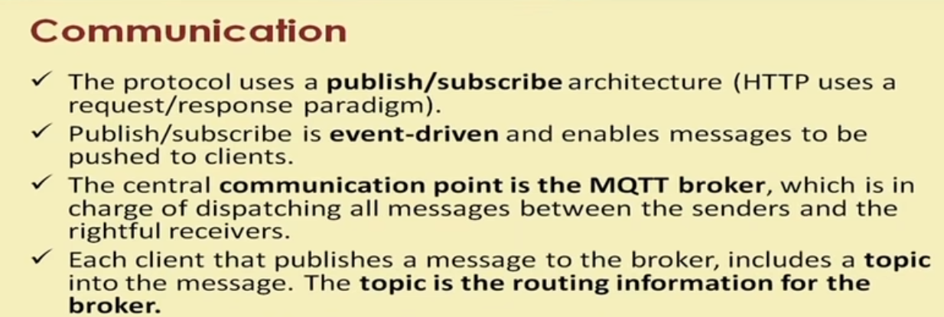

Slide 19
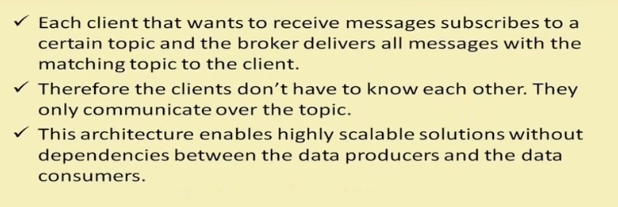

Slide 20
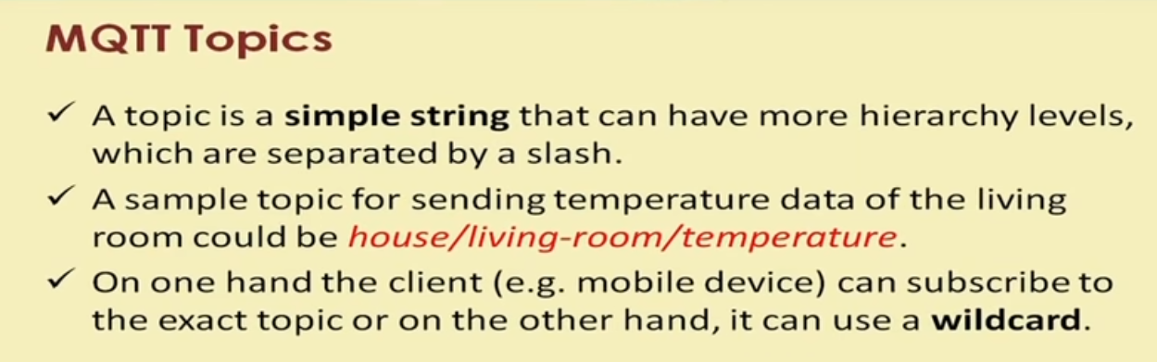

Slide 21
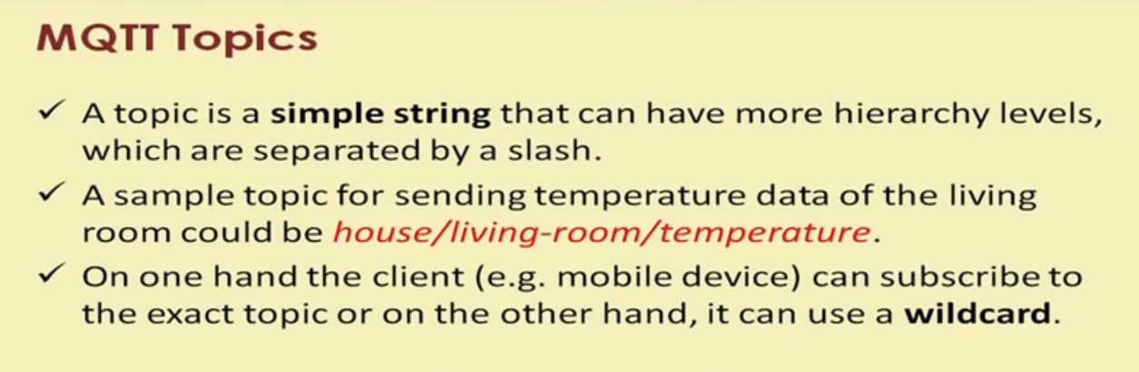

Slide 22
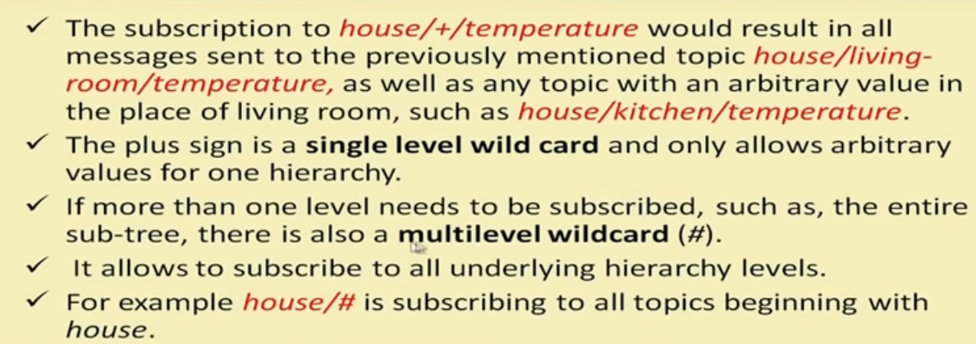

Slide 23
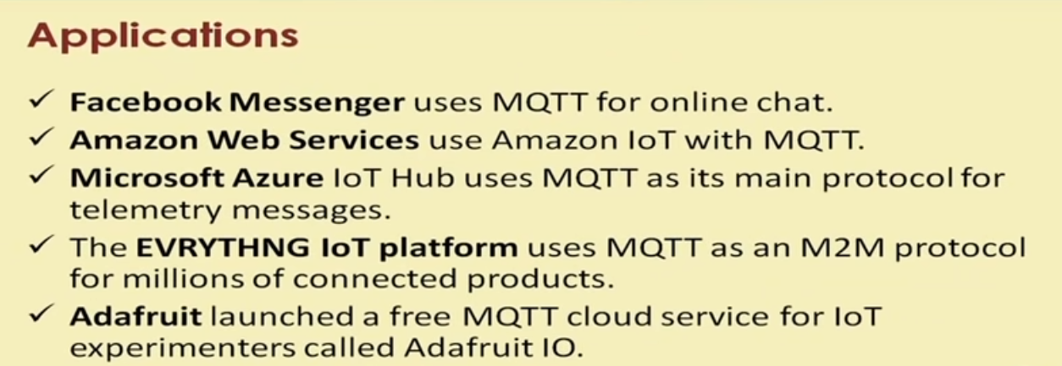

Slide 24
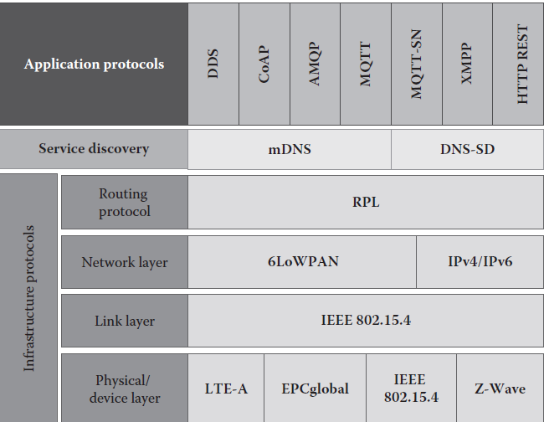

Slide 25
6LoWPAN
Lowpower Wireless Personal Area Networks.
The 6LoWPAN system is used for a variety of applications including wireless sensor networks.
The 6LoWPan technology is nothing but a simple wireless mesh technology that makes the individual nodes IP-enabled

Slide 26
6LoWPAN
Low Power devices with limited processing power need to be part of the internet of things.
Using 6LowPAN, the smallest of the IOT devices can now be part of the network and can talk to the outside world.
Ref: https://www.plugintoiot.com

Slide 27
6LoWPAN
LoWPANs follows the IEEE 802.15.4 – 2003 standard [IEEE 802.15.4].
IEEE 802.15.4 is a standard for low power, low data rate wireless communication between small devices.
Some characteristics of LoWPANs are
Low power
small packet size,
low bandwidth
low cost

Slide 28
6LoWPAN
802.15.4 is a MAC and PHY layer protocol (OSI Layers 1 and 2 ).
ZigBee is a network layer ( OSI Layer3 ) protocol which sits on top of IEEE 802.15.4

Slide 29
6LoWPAN
Example of LED streetlights
Switch off all the streetlights in your street using an app in your smartphone.
Need just a command to switch off the LED.
6LoWPAN technology enable the LED streetlights.

Slide 30
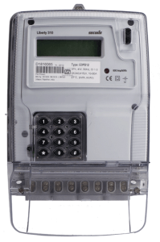
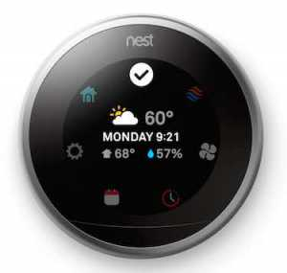
Applications based on 6LoWPAN
Smart meters and the smart grid
An electricity supply network that uses digital communications technology to detect and react to local changes in usage.
A smart meter is an electronic device that records consumption of electric energy and communicates the information to the electricity supplier for monitoring and billing.

Slide 31
The devices that are present in a 6LoWPAN network can be classified into two categories:
Routers
Hosts
Routers are devices that route data to other nodes in the 6LoWPAN network.
Hosts are also known as end point devices, and they do not have the capability to route data to other devices in the network.

Slide 32
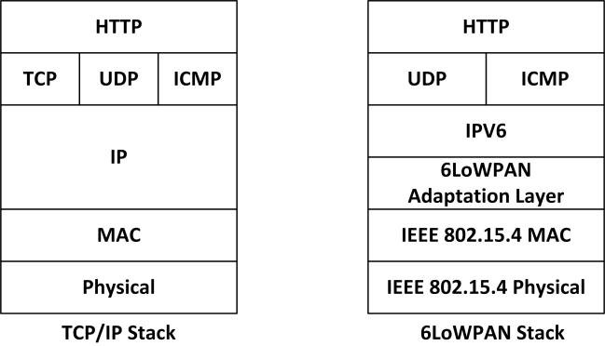
Protocol Stack

Slide 33
Physical layer:
This layer in the OSI model is responsible for the conversion of data bits into signal that can be transmitted through air.

Slide 34
Data link layer: This layer ensures that a reliable connection or link is established between two nodes by correcting the errors that occur in physical layer during data transmission.
The media access control (MAC) layer that provides access to the media is also present in the data link layer.
In 6LoWPAN, IEEE 802.15.4 is the MAC layer. The adaptation layer of 6LoWPAN that provides adaptation from IPv6 to IEEE 802.15.4 is also present in the data link layer.

Slide 35
Network layer:
This layer is responsible for routing of data in the network.
This layer ensures that data or packet from a source device is delivered to the correct destination device.
The devices are identified using their IP address, which is assigned by using the Internet protocol (IP). In 6LoWPAN, IPv6, is used in the network layer.
Notes:
Refer network architecture and its explanation from the book “ THE INERNET OF THINGS’” BY Raj and Anupama”

Slide 36
Header compression
In many services and applications e.g., Voice over IP, interactive games, messaging etc, the payload of the IP packet is almost of the same size or even smaller than the header.
Over the end-to-end connection, comprised of multiple hops, these protocol headers are extremely important but over just one link (hop-to-hop) these headers serve no useful purpose

Slide 37
It is possible to compress those headers.
IP header compression is the process of compressing excess protocol headers before transmitting them on a link and uncompressing them to their original state on reception at the other end of the link.
On low bandwidth networks, using header compression results in better response times due to smaller packet sizes

Slide 38
A small packet also reduces the probability of packet loss due to bit errors on wireless links.

Slide 39
6LoWPAN is very promising for use in the IoT market because of the following reasons
Support for IP communication
Support for large mesh network topology
Very low power consumption
Robust communication capabilities

Slide 40
RPL
Routing protocol for low power and lossy networks.
Distance vector routing protocol.
Routing based on destination oriented Acyclic graph or DODAGs.

Slide 41
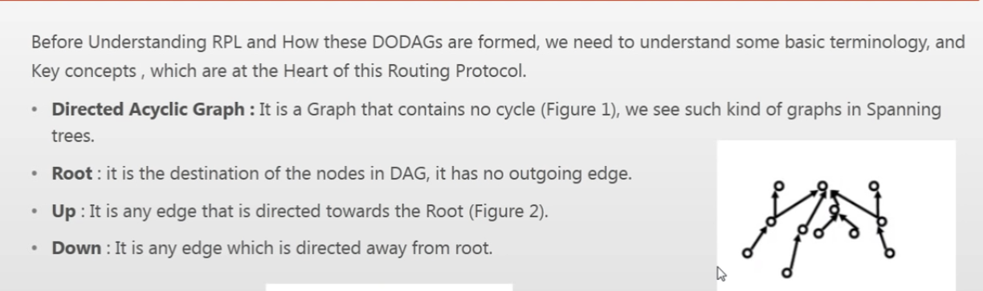

Slide 42
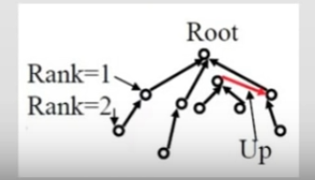

Slide 43
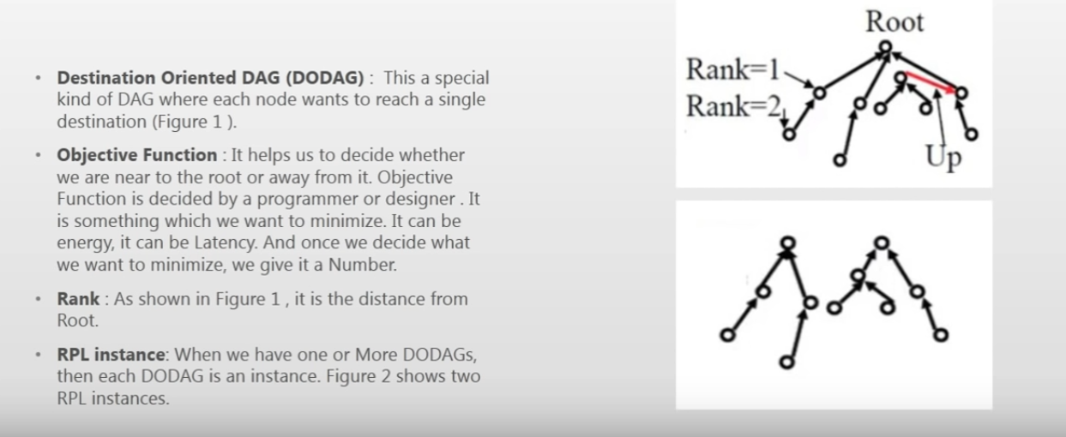

Slide 44
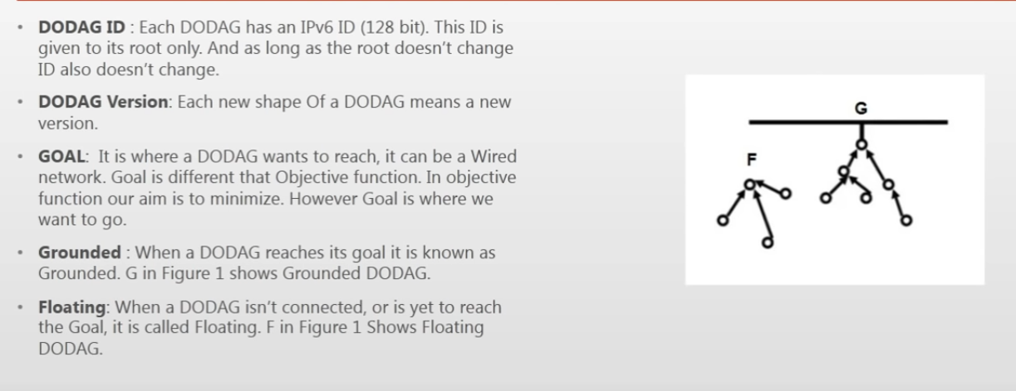

Slide 46
Protocol provides support for various types of traffic models:
Multi point to- point,
point-to-multipoint,
and point-to-point
Devices in the network that use this protocol are connected to each other in such a way that no cycles are present in the connections

Slide 47
DODAG
A node called destination oriented directed acyclic graph (DODAG), which is routed at a single destination, is built initially.
Special kind of DAG where each node wants to reach a single destination.
It helps us to decide whether we are near to the root or away from it.

Slide 48
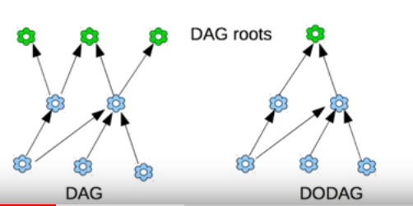
DAG and DODAG

Slide 49
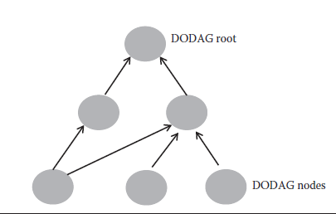
DODAG topology

Slide 50
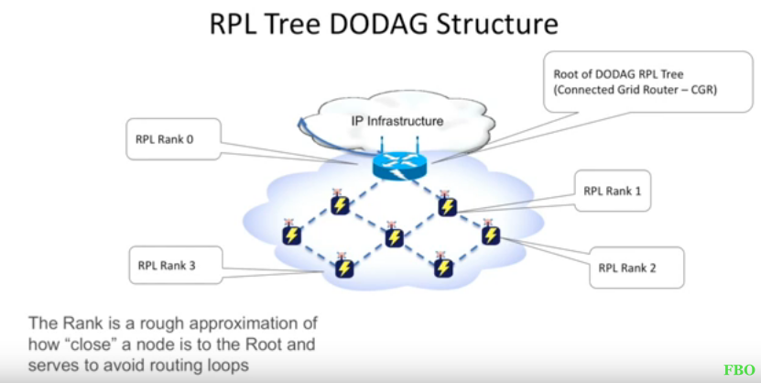

Slide 51
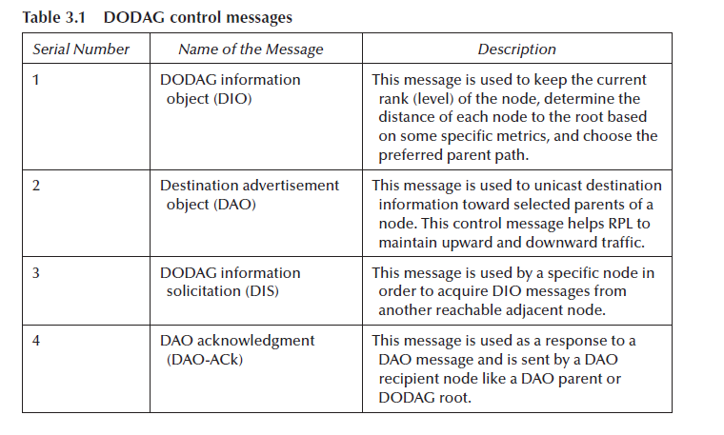

Slide 52
CoAP
Constrained Application Protocol designed for machine to machine communication.
New communication protocol.
This protocol uses minimum resources and bears similarities to the standard web protocol HTTP.
Able to provide strong encryption.
Used in a limited network like in a domestic environment.

Slide 53
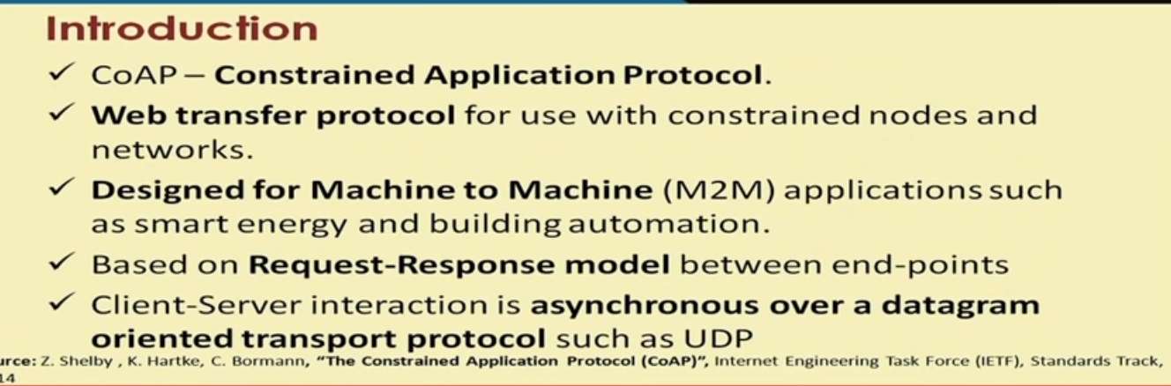

Slide 54
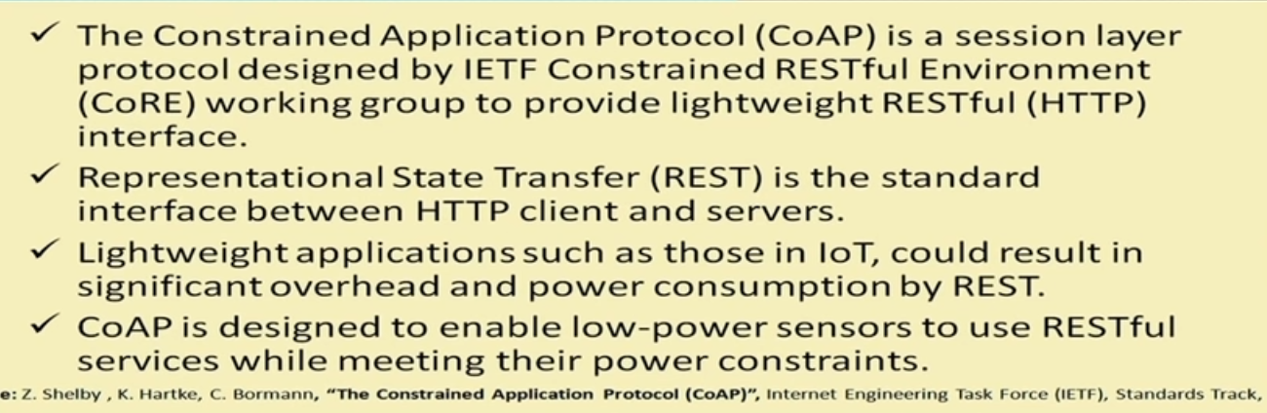

Slide 55
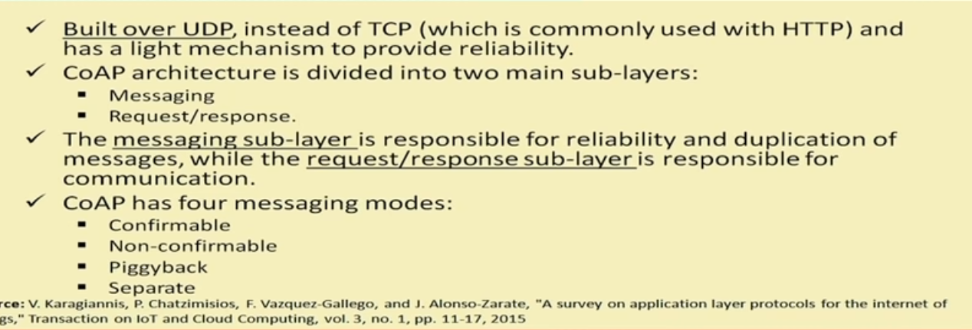

Slide 56
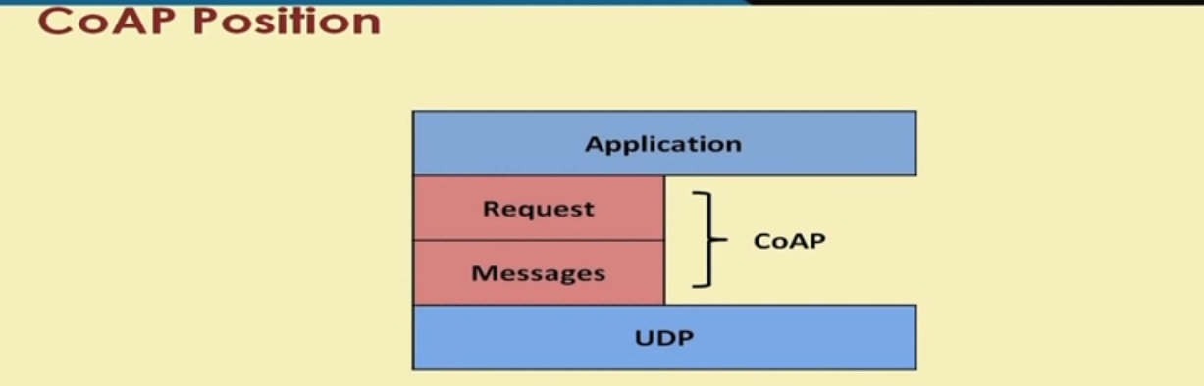

Slide 57
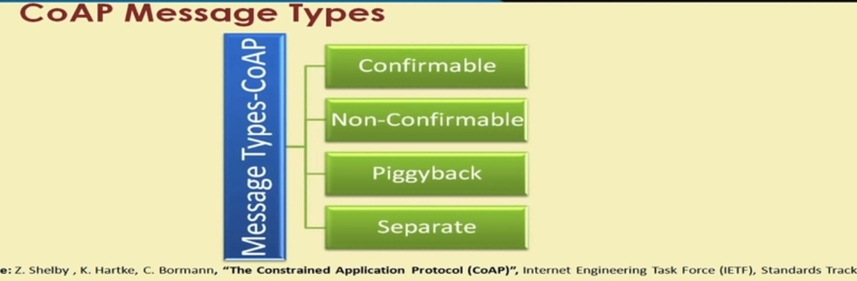

Slide 58
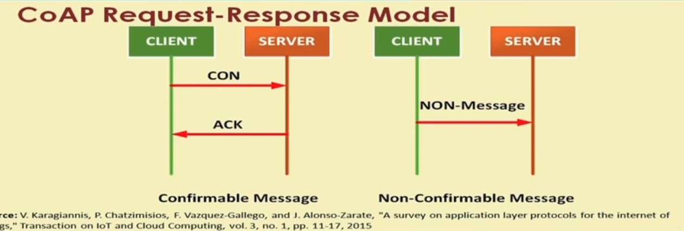

Slide 59
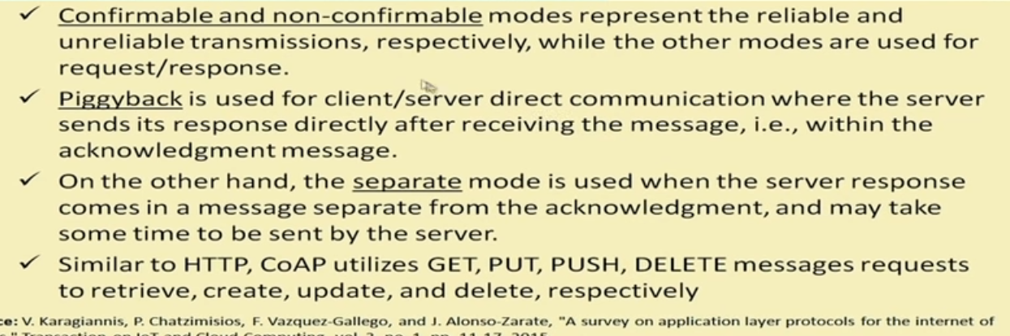

Slide 60
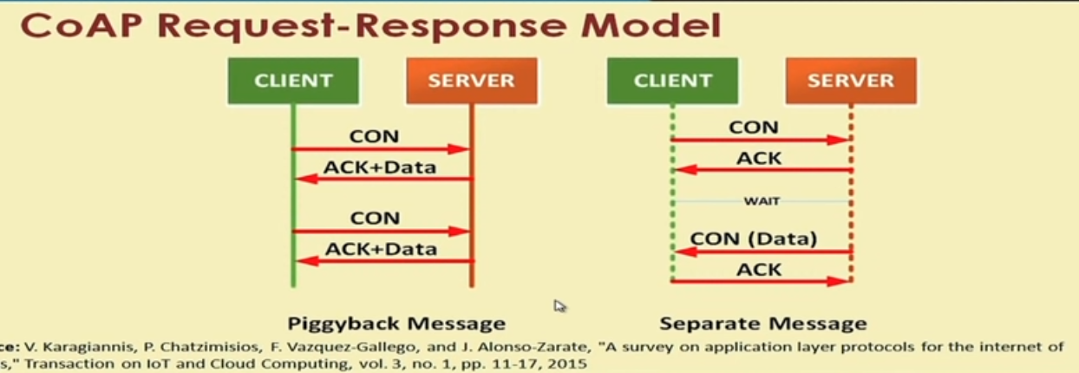

Slide 61
CoAP
Developed by IETF( Internet engineeringT ask Force).
Developed to enable smart devices to connect to the Internet,,1to 1communication protocol .
CoAP runs over UDP, not TCP.
CoAP is based on Client server model.

Slide 62
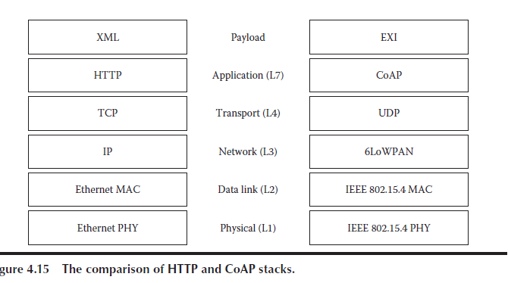

Slide 63
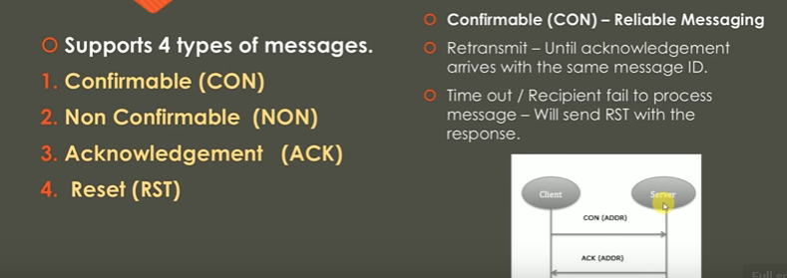

Slide 64
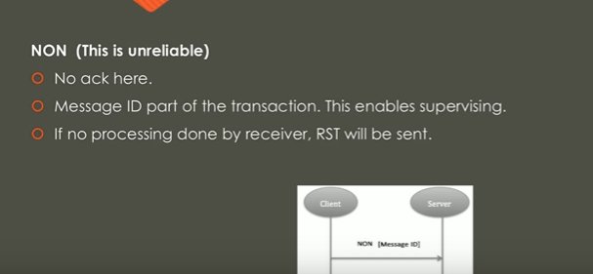

Slide 65
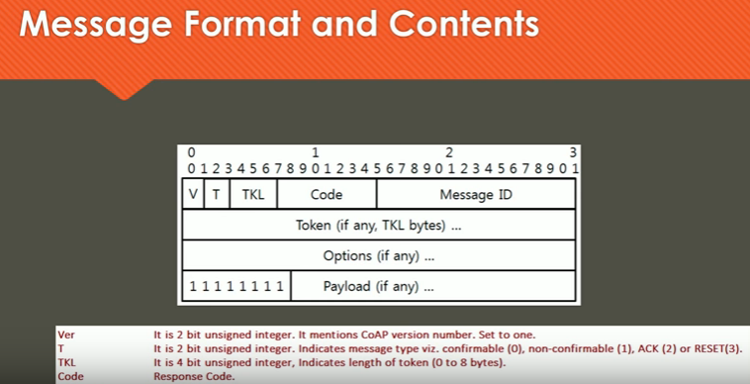

Slide 66
Summary
CoAP is a software protocol intended to be used in very simple electronics devices
that allow them to communicate interactively over the Internet.
It is particularly targeted for small
low-power sensors, switches, valves, and other similar components.

